Slide 1



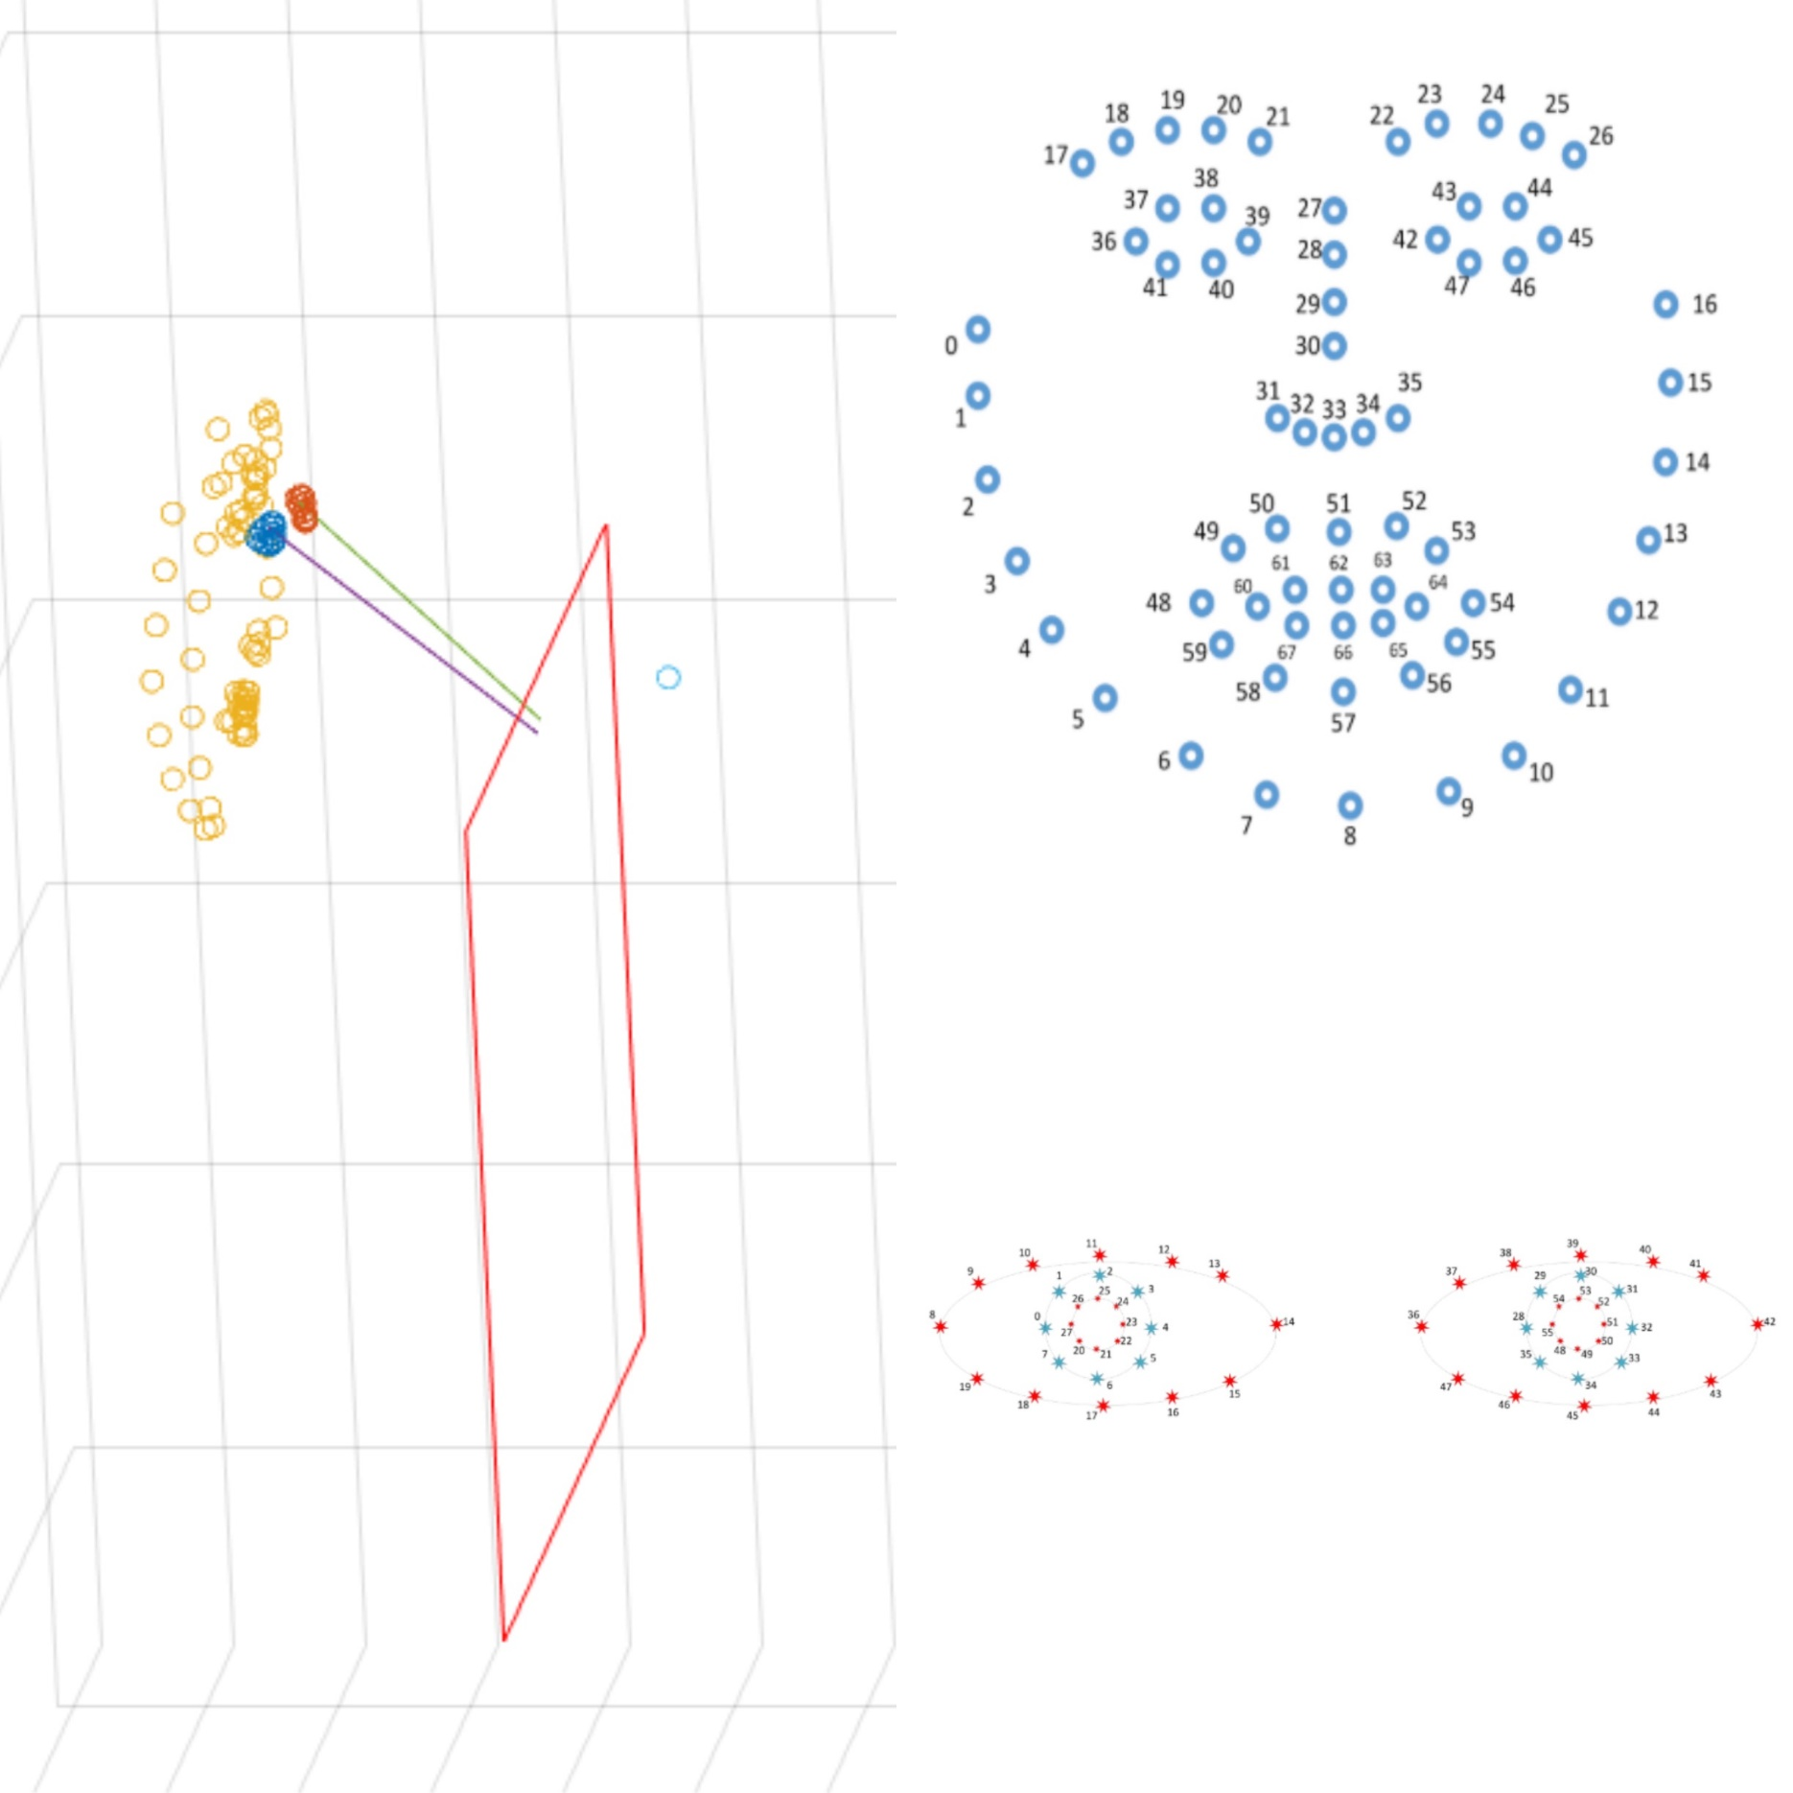
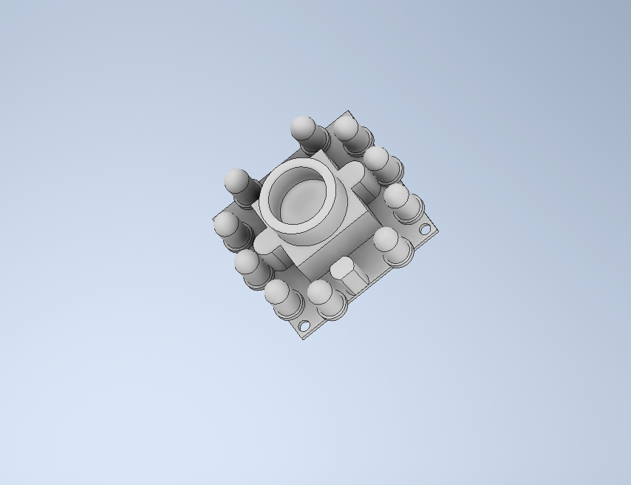
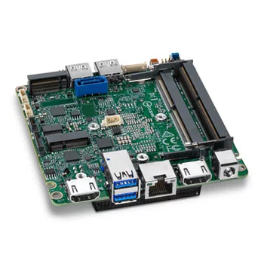
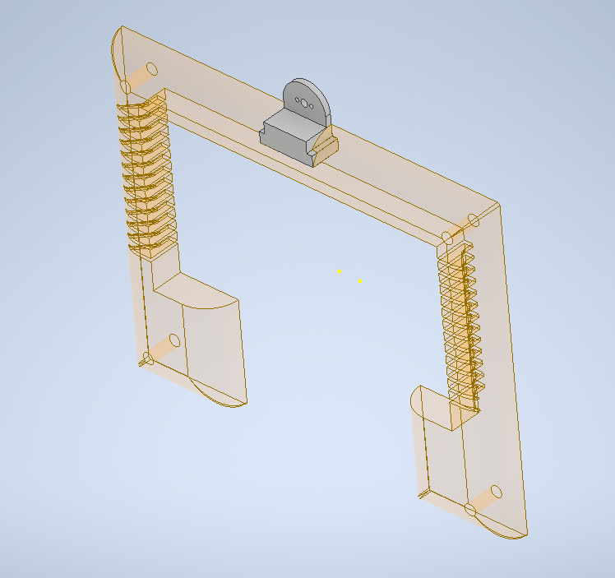
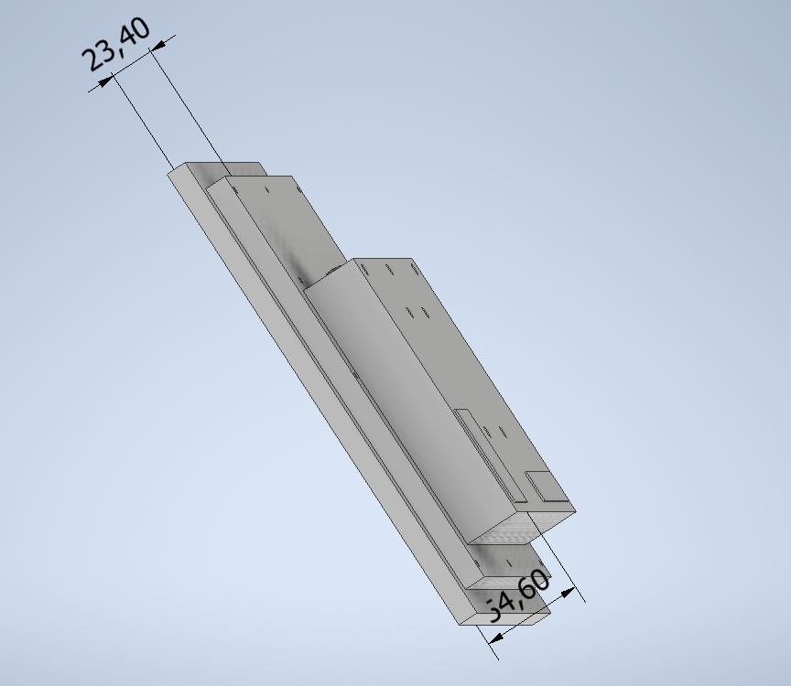
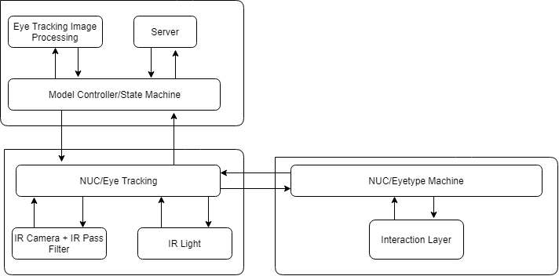
Real-Time Eye Tracking Remote
Eye-T Guys
George Hinkel, Jonathan El-Khoury, Dharampreet Gill, Paul Wafula, Jay Denton
Spring-Summer 2019
University of Texas at Arlington, CSE Department
Vision
Requirements
Detailed Design
Our vision is to create a new eye tracking system for Marci to replace her current system which no longer has continued support from the original manufacturer and is dangerously close to failure. By creating this system, it will allow Marci to continue to be able to communicate with her family even in the event of failure of her current system. However, if her current system continues to function then she will continue to use that and keep our system as an emergency backup.
Customer Requirements: The main feature of the Eye Tracking Remote is to find the coordinates where the user’s pupils are focusing at on the screen. Then the Eye Type software will cooperate to allow user to type statements and communicate with other people. One camera with IR lens and IR lights is used to capture user’s eye positions and movements. The image information goes to INTEL NUC embedded computer for digital processing. And the calculated screen coordinates and eye gesture commands will be sent to Eye Type software for later on process analysis. An external battery is needed for TX2. The computer display will be used to visualize the pictures captured by the cameras and also data analysis on the TX2. The information will be displayed in the background in Linux Terminal for debugging purposes.
The Eye Tracking Remote has two main layers: the Software Layer and the Hardware Layer. The Software Layer implements the eye-tracking algorithm using the image data imported from the Hardware Layer. It also calibrates gaze vector to screen coordinates conversa-
tions and wraps up the analyzed data in a packet which will be sent to EyeType’s portion of the project. The Hardware Layer consists of the IR light and the camera to capture the user‘s pupil movements and sends this data to the Software Layer. It also sends the analysed data packet imported from the Software Layer to the EyeType system. Meanwhile, the analyzed data is also shown on the Character LCD for debugging purposes.
Mission
In order to realize our vision, we will construct a new eye tracking system. This will involve using an embedded computer development board (Intel NUC) and attaching a remote cameras to it. Our plan is to utilize and retrofit leopardimaging camera. The camera will be responsible for tracking both of Marci’s eyes thus giving Marci the ability to communicate with her family and others. The camera will be outfitted with infrared lights as well as infrared filters (which will be used to block out all visible light). Upon completion, this system will then be mounted to Marci’s current battery-powered wheelchair.
Packaging: Camera is used for eye tracking and a mount is designed to contain the exposed PCB, hold any lenses or filters needed in front of the sensor, hold the IR lights to illuminate the viewing target, and with any manual articulation device so that the camera may be pointed at the customer’s eye, or the possible low priority automatic articulator.
Screen is used to display keyboards and available to type from.
A battery is necessary to meet the mobility requirements of the customer and to power the eye tracking system.
The embedded controller must have a custom PCB fabricated that contains all the necessary peripheral ports and pin outs for the design, and must be designed with screw holes to be mounted inside its enclosure which also must be designed with ports for power and any outputs or inputs, and with a power light, and place for the character LCD display.
Current Status
Completed tasks:
Find the eye/pupil landmarks from the streaming video
Map eye gaze vector coordinates and gaze angle to pixels on the screen
Setup server for eye gaze information transfer between Eye Tracking and Eye Type software
Setup backup battery
Print Model Product Casing
Assemble prototype
Background
Maintenance and Support: The eye tracking system will be on version control after we built it. The camera and the screen won’t really need much maintenance unless they really break down, then our only choice is to replace them.
Marci is a former UTA Alumnus and the product owner. She has been living with ALS for years now and needs an eye tracker and typing system to communicate. She has been using the same system for years since it was reliable and she was skilled at using it, however the manufacturer was bought out and support for the device was dropped, so they are in need of a new system as their current eye typing system decays without software or hardware support. Our team, EyeTGuys, was tasked with the creation of the hardware eye tracking system consisting of remote cameras, and a machine to run the image processing. Our sister team, EyeType was tasking with creating the accessibility tool and keyboard app extension.
In Progress:
Enhance the calibration and mapping of gaze vector to screen coordinates.
Better connection between Eye Tracking and Eye Type software
Mount leopardimaging camera
Architecture Design
The Eye Tracking Remote has two main layers: the Software Layer and the Hardware Layer. The Software Layer implements the eye-tracking algorithm using the image data imported from the Hardware Layer. It also calibrates gaze vector to screen coordinates conversions and wraps up the analyzed data in a packet which will be sent to EyeType’s portion of the project. The Hardware Layer consists of the IR light and the camera to capture the user‘s pupil movements and sends this data to the Software Layer. It also sends the analysed data packet imported from the Software Layer to the EyeType system.
References
OpenCV, a library of programming functions mainly aimed at real-time computer vision.
OpenFace, open source for facial detection, eye gaze detection.
Leopardimaging, LI-USB30-MIPI-TESTER and LI-OV4689-MIPI.

